Slide 1
CS4222
Principles of Database System
PostgreSQL Tutorial
Huiping Guo
Department of Computer Science
California State University, Los Angeles

Slide 2
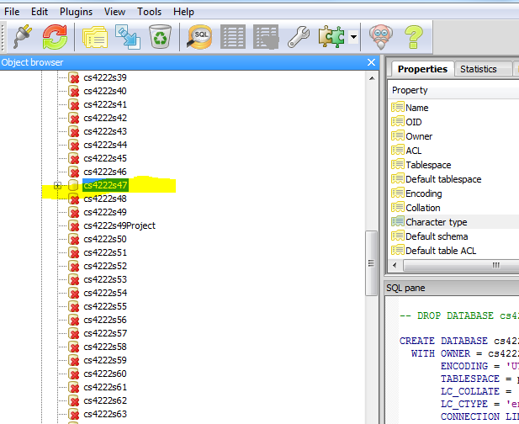
1. Select your own database
CS4222_Su18

Slide 3
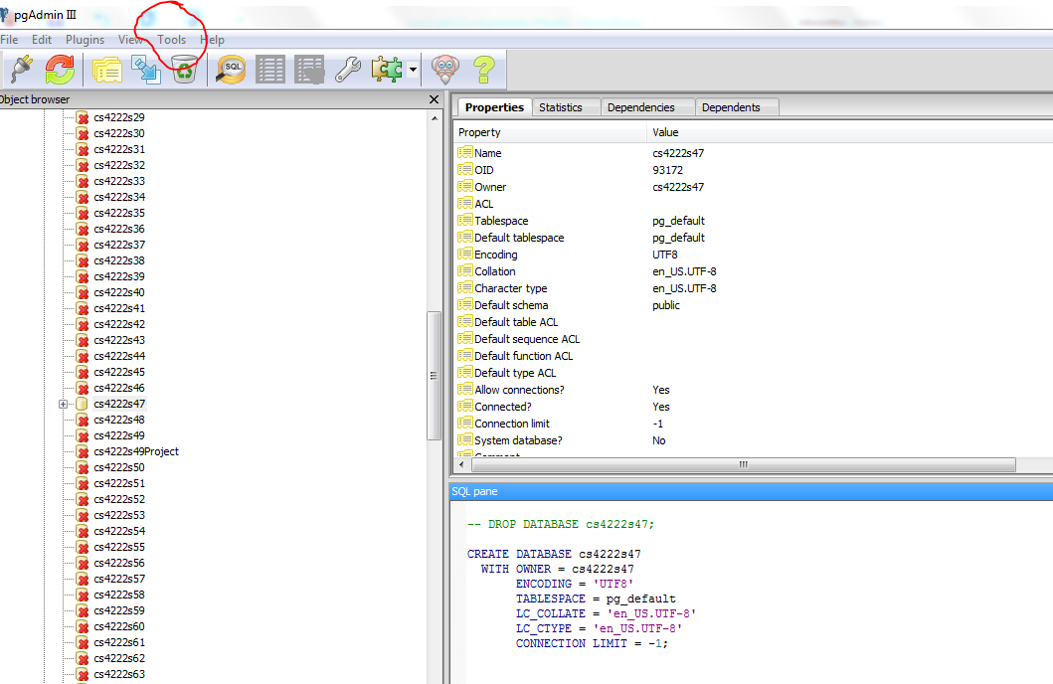
2. Open the query editor
Click on Tool and select “Query tool”
CS4222_Su18

Slide 4
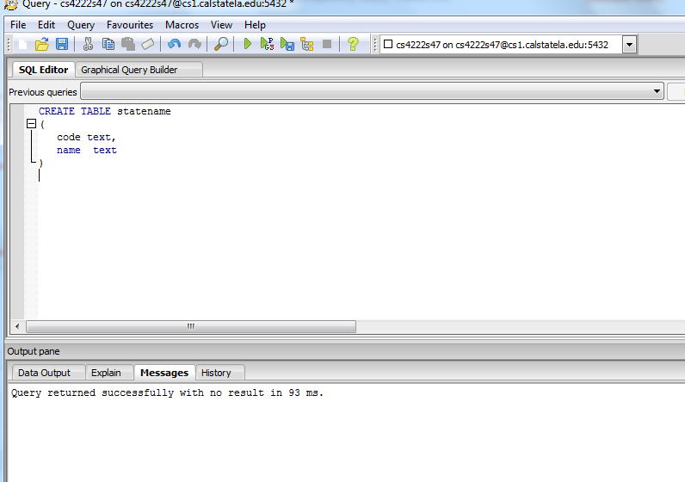
3. Run queries
Copy & paste your queries in the query editor and click on to run the queries
CS4222_Su18

Slide 5
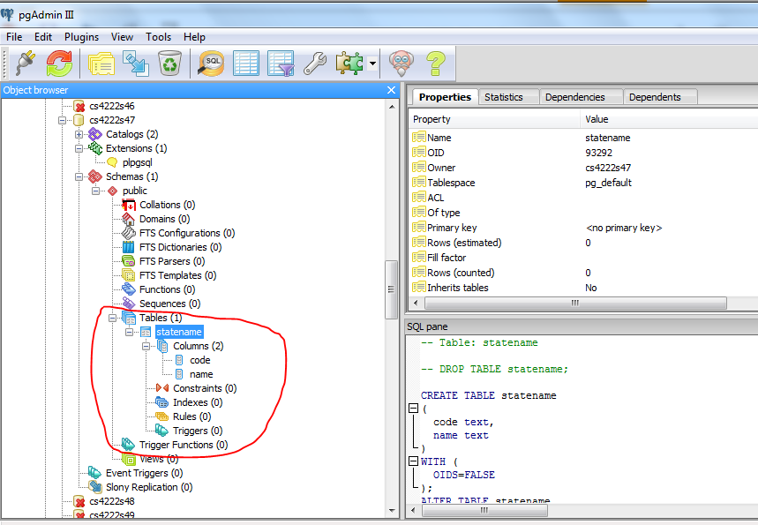
4. Check the new table
CS4222_Su18

Slide 6
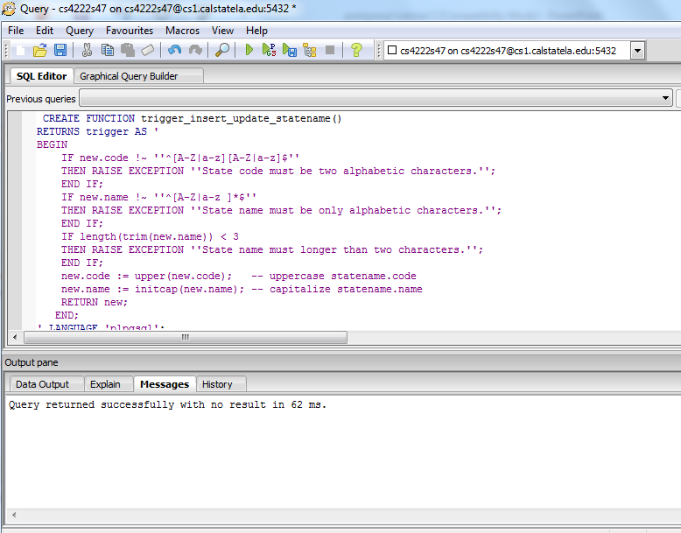
6. Create a function
Copy & paste your function in the query editor and run it
CS4222_Su18

Slide 7
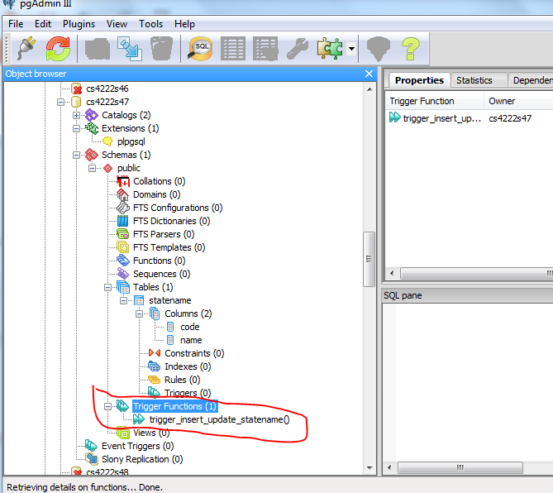
7. Check the new function
CS4222_Su18

Slide 8
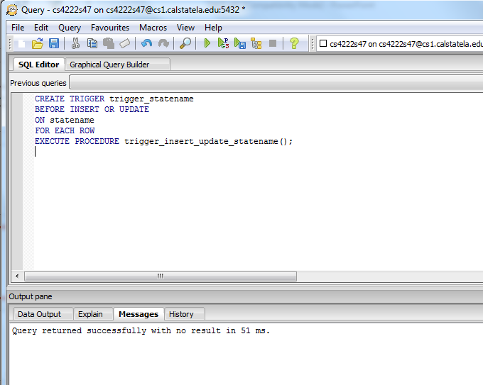
8. Create a trigger
Copy & paste your trigger in the query editor and run it
CS4222_Su18

Slide 9
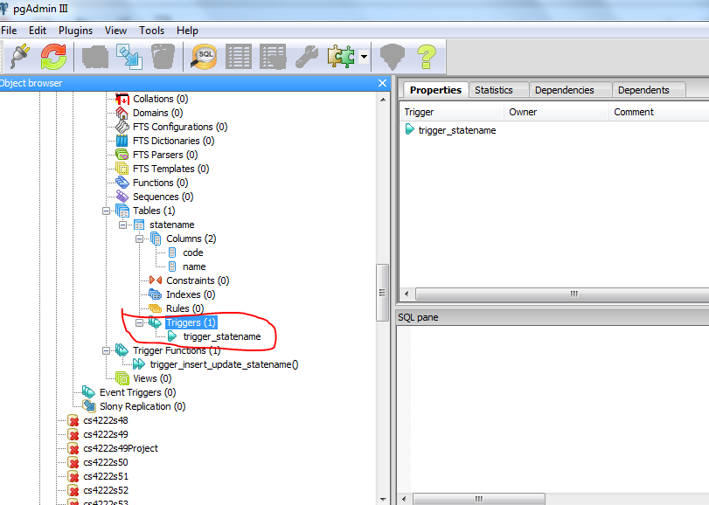
9. Check the new trigger
CS4222_Su18

Slide 10
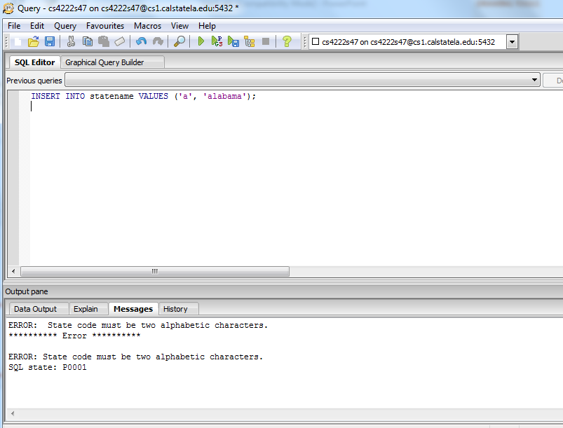
10. Test the new trigger
CS4222_Su18

